Slide 1
Module 4: Modern Deep Learning Architectures - Part 1
Fall 2025

Slide 2
Outline
Fully Connected Neural Networks
Theory
Practical Example
Convolutional Neural Networks (CNN)
Theory
Convolution Practical Example
CNN Practical Example
Class Activity: Adding a CNN model to the reusable codebase

Slide 3
Fully Connected Neural Networks

Slide 4
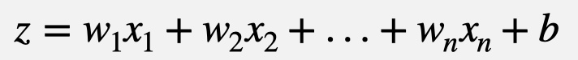

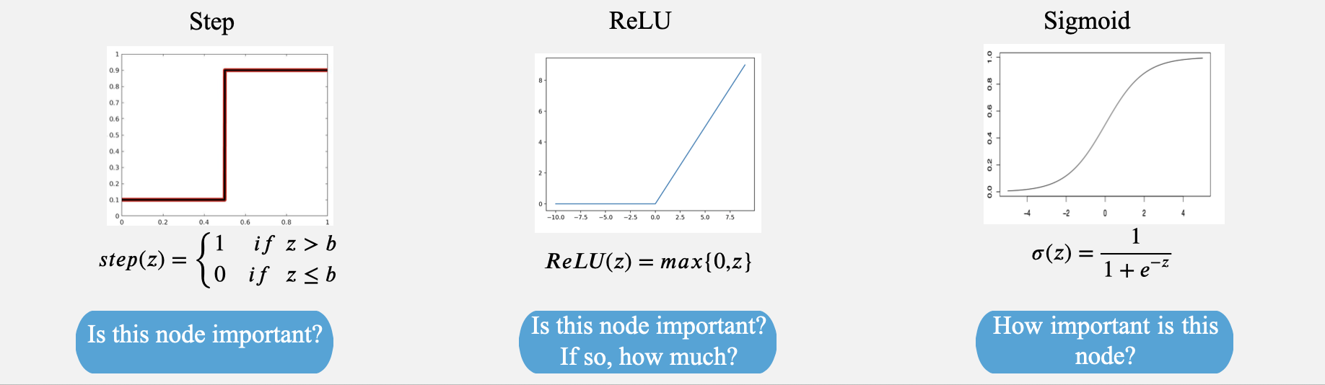


Introduction
The Neuron
Each artificial neuron consists of a linear combination of its inputs followed by a nonlinear activation function:
Weights determine the influence of each input feature on the output
Activation function determines the output of a neuron, allowing the network to model complex patterns

Slide 5
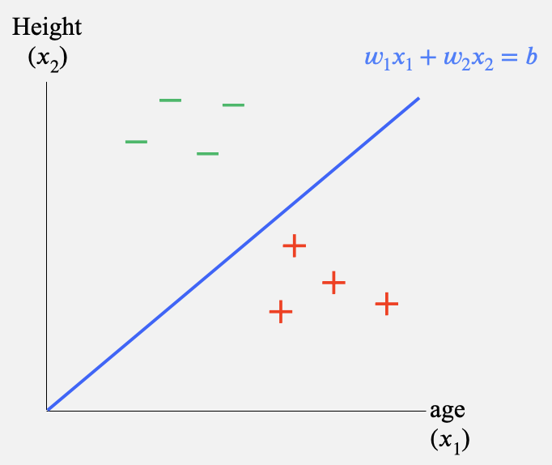
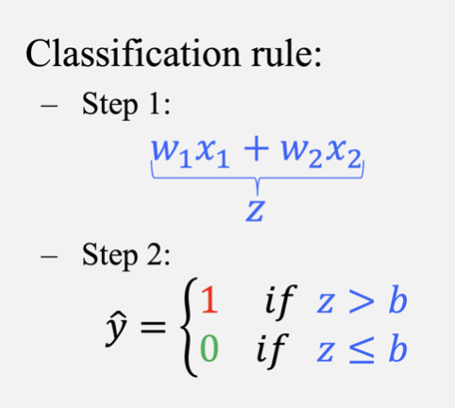
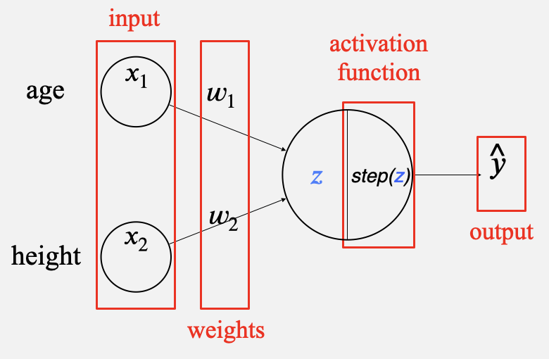
Example
Classification

Slide 6
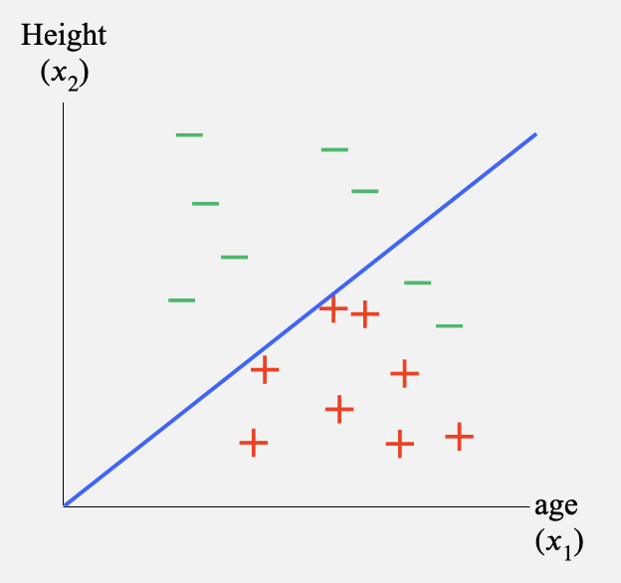
Example
Classification
mis-classify

Slide 7
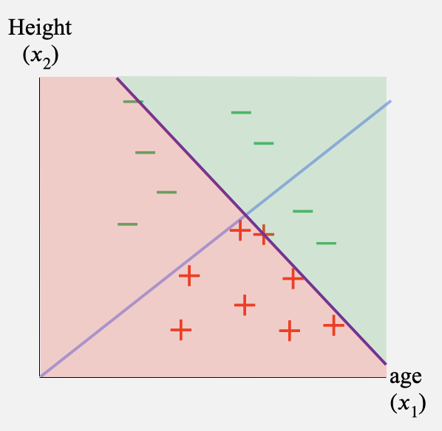
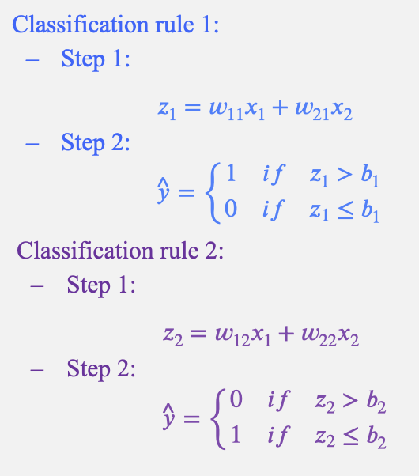

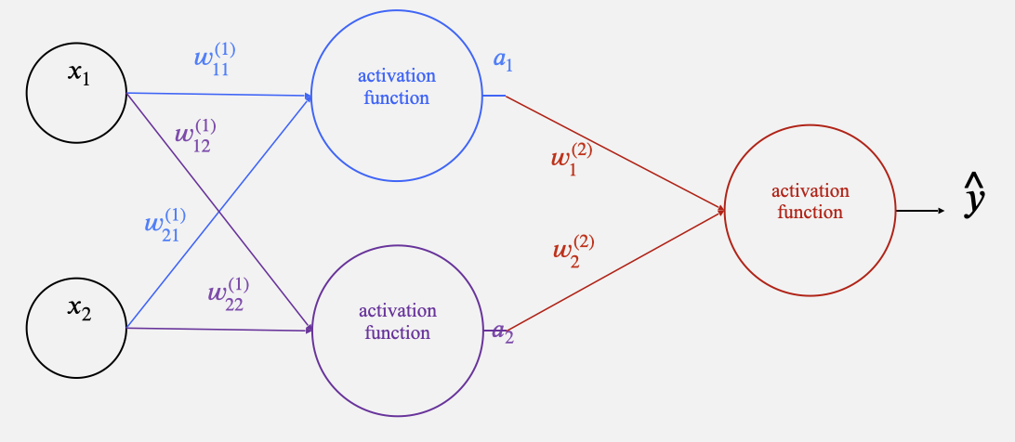
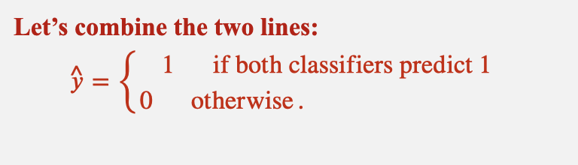
Example
Classification

Slide 8
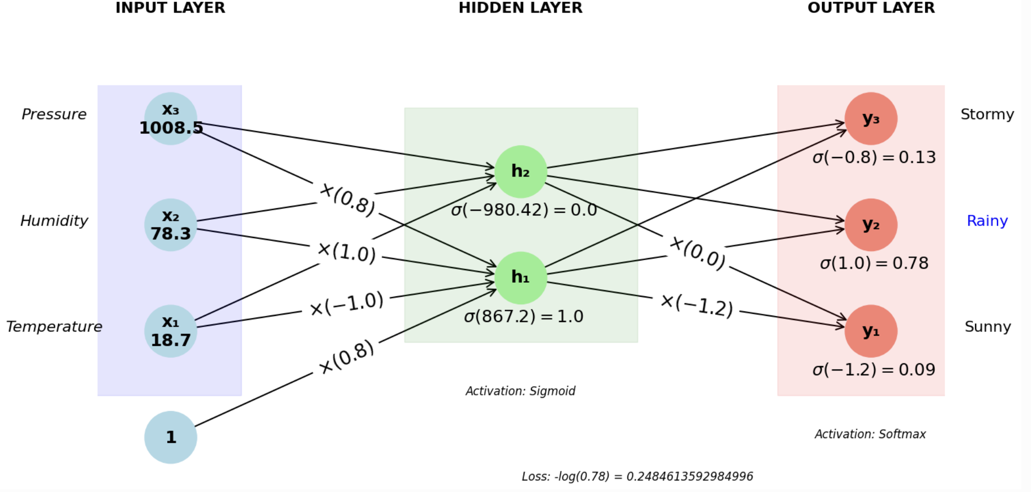
Fully Connected Network
Inputs to a fully connected neural network can be represented as a 1D vector, for example:
x = [18.7, 78.3, 1008.5].
The structure of a fully connected neural network:
Note that we represent the bias term using an extra “fake” feature with a value 1, so that the mapping can be represented as a linear operation using only matrix (or more generally tensor) multiplications.

Slide 9
Batches
However, neural networks typically process training and test examples in batches.
A batch consisting of three training examples and three labels:
[[28.5, 45.0, 1015.2],
[18.7, 78.3, 1008.5],
[22.1, 85.6, 998.7 ]],
["Sunny", "Rainy", "Stormy"]
Each input above can be represented with two indices:
[index of the example in the batch, feature]
Notice the matrix structure.
For more complicated inputs, we need to deal with tensors, which are multidimensional structures that generalize vectors and matrices.

Slide 10
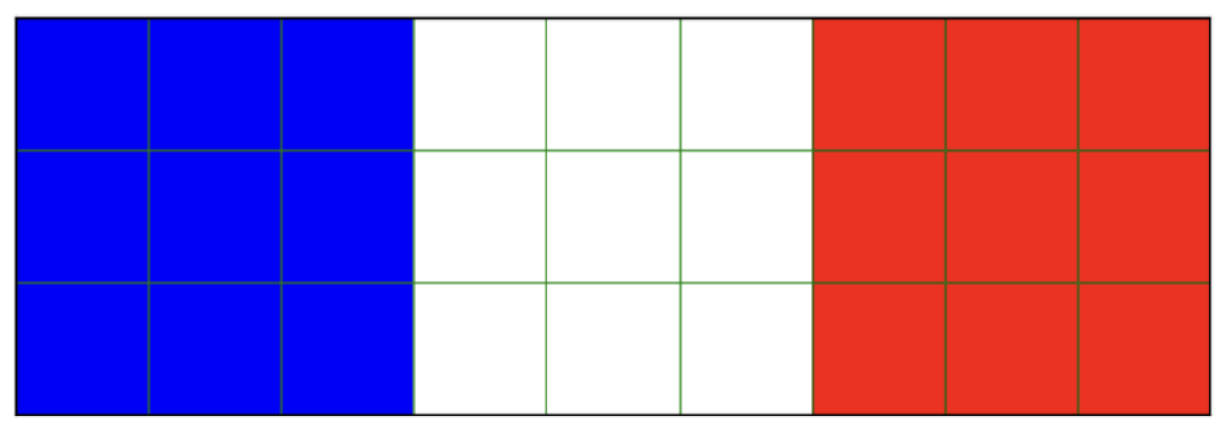
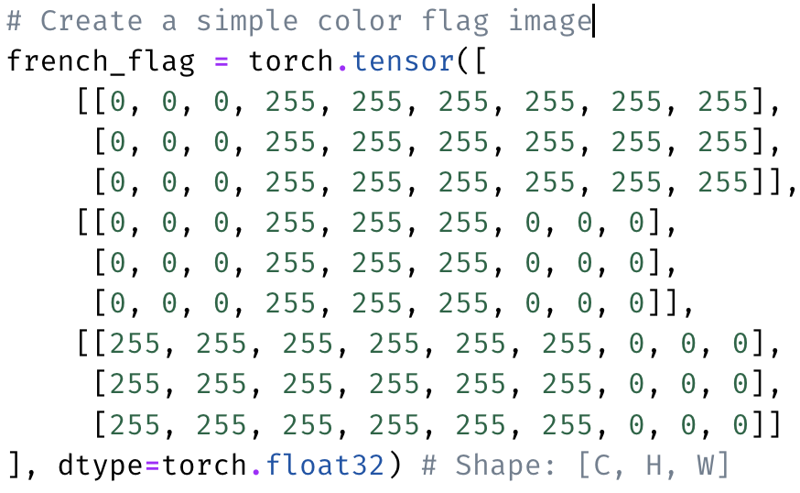
Tensors
Each element of a vector is indexed by one number.
Each element of a matrix is indexed by two numbers: [row, column]
An n-dimensional tensor is indexed by n numbers
In image processing, typically each input represents a color value of a pixel corresponding to [channel, row, column], where channel contains pixel intensities of red, green, and blue channels.
Batch dimension gives a 4D tensor indexed by: [index in batch, channel, row, column]
or
[index in batch, row, column, channel]

Slide 11
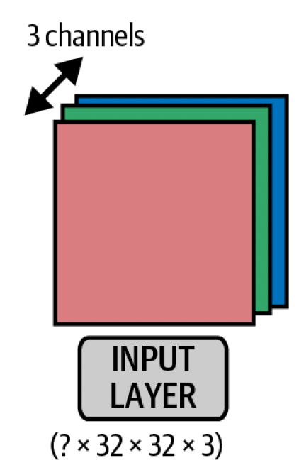
Visualizing 4D Tensors
To visualize this:
Imagine a matrix of pixel values, representing an image of a specific height and width.
Each pixel has three channel values (red, green, and blue), which can be visualized as the depth of the tensor.
The batch dimension allows modern GPUs to process multiple images at once, effectively stacking these 3D image tensors into a 4D structure.
This structure is essential for handling image data in deep learning models.
Image Source: Foster, D. (2024). Generative deep learning: Teaching machines to paint, write, compose, and play (2nd ed.). O'Reilly Media.

Slide 12
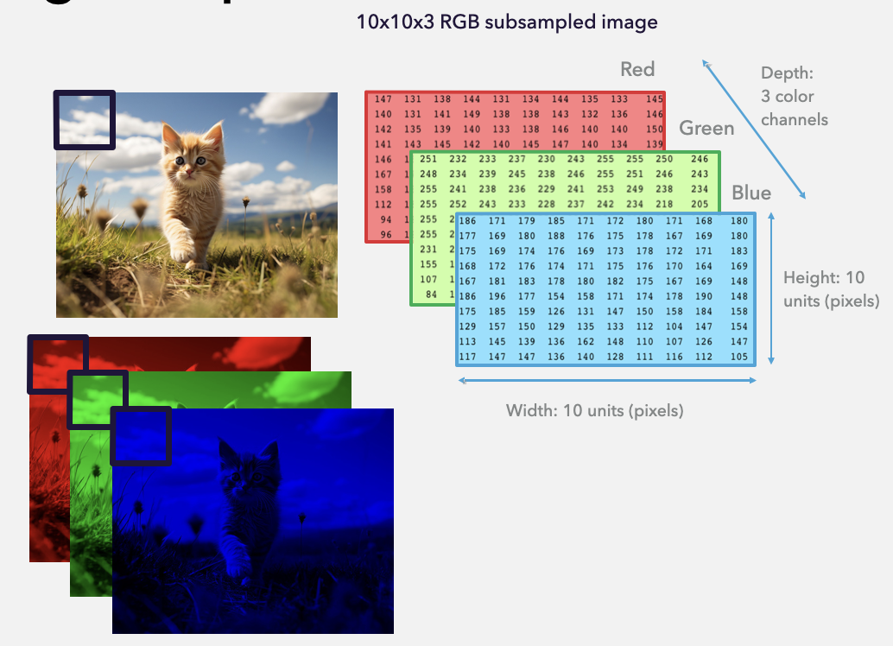

Visualizing 4D Tensors

Slide 13
Common Tensor Operations
squeeze / unsqueeze – Adjusting Dimensionality
squeeze removes dimensions of size 1 (useful for eliminating unnecessary axes).
unsqueeze adds a new dimension at a specified position.
flatten – Converting a Multi-Dimensional Tensor into a 1D Tensor
Useful for preparing data before passing it into a fully connected (dense) layer in a neural network.

Slide 14
Common Tensor Operations
Data Manipulation
permute - changes the order of dimensions (e.g. to move the channel from the second dimension to the fourth). No data copy, just changes how we index it.
view - modifies the tensor shape while keeping the same number of elements - no copying of data.
reshape - similar to view, but works even when memory is not contiguous - might copy data.
to(device) – Moving Tensors to CPU/GPU
Deep learning models often run on GPUs for faster computation.
to(device) moves a tensor to CPU or GPU based on availability.

Slide 15


Loss Function
To train a neural network, we need to measure how well its output approximates the correct label from the dataset.
This is achieved using a loss function, which quantifies the difference between the predicted and actual values.
For regression problems, a common choice is the Mean Squared Error (MSE) loss, which calculates the average squared difference between predictions and true values.
For classification problems, we often use the Cross-Entropy Loss, which measures how well the predicted probability distribution aligns with the actual labels.

Slide 16
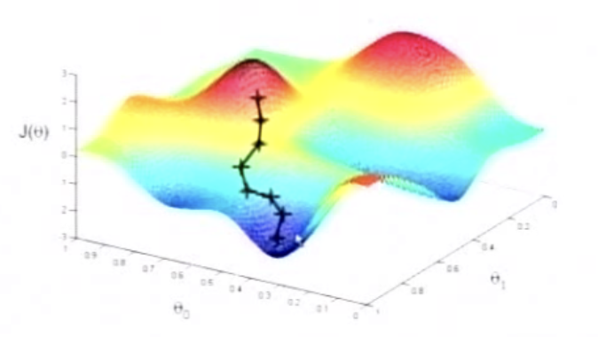
Optimization
Optimization is the process of adjusting model parameters (weights and biases) to minimize the loss function.
Mathematically, to understand how a small change in the weights influences the loss function, we use the concept of the gradient.
Simply put, the gradient measures the rate of change of the loss function with respect to the weights. It tells us how much the loss will change if we make a small adjustment to the weights.

Slide 17
Optimization
Optimization is the process of adjusting model parameters (weights and biases) to minimize the loss function.
Gradient is a vector consisting of partial derivatives of the loss function with respect to the weights. Changing the weights in the direction opposite to the gradient makes the loss smaller.

Slide 18
Model Training
Initialization and Forward Propagation
Initialization
Initialize network weights and biases (typically randomly or using specialized methods like Xavier initialization or He initialization).
Forward Propagation
Pass the input data through the network layer-by-layer, computing linear combinations and activations through each hidden neuron.
Loss Computation
Calculate the loss function (e.g., MSE, Cross Entropy) by comparing predicted output to true labels.

Slide 19
Model Training
Backward Propagation
Backpropagation
Compute gradients of loss with respect to each weight/bias using the chain rule (backward pass).
Optimization
Update weights and biases using gradients from the backward pass.
Common optimizers: Gradient Descent, Stochastic Gradient Descent (SGD), Adam, RMSprop.
Iteration
Repeat forward and backward passes iteratively through multiple epochs until convergence or stopping criterion.

Slide 20
Model Evaluation and Deployment
Evaluation
Evaluate performance on validation/test data to assess generalization and prevent overfitting.
Hyperparameter Tuning
Adjust hyperparameters (learning rate, epochs, batch size, layers, etc.) based on validation performance.
Evaluation and Deployment
Evaluate performance on unseen test data.
Deploy the trained model into production or for practical use.

Slide 21
Deep Learning Frameworks
Practical:
Fully Connected Neural Networks (FCNN)
Luckily we don’t have to implement all of this from scratch. Frameworks like TensorFlow (Google) and Torch (Meta) abstract away a lot of the complexity.
To get practice with both TensorFlow and PyTorch:
Textbook code is implemented in TensorFlow.
In class we will use PyTorch.

Slide 22
Convolutional Neural Networks

Slide 23
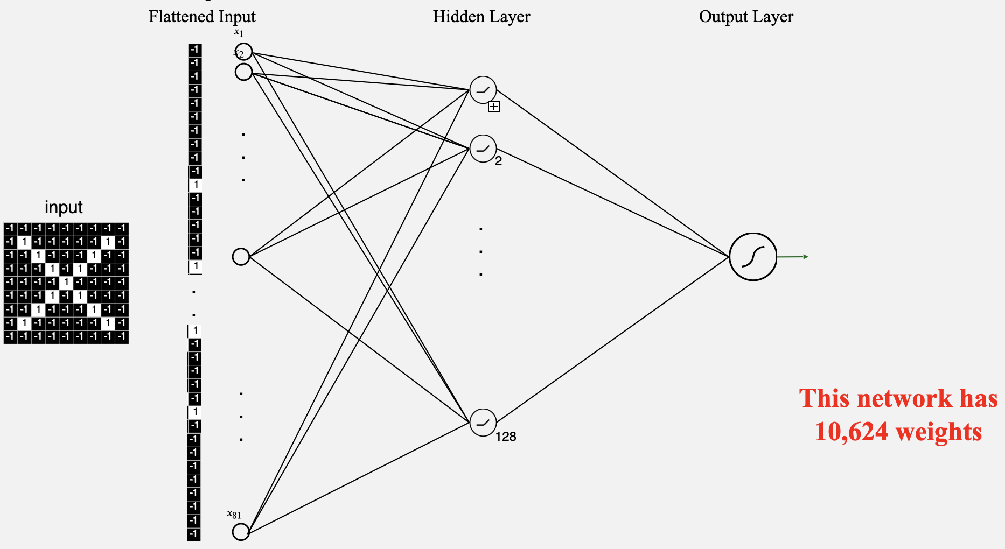
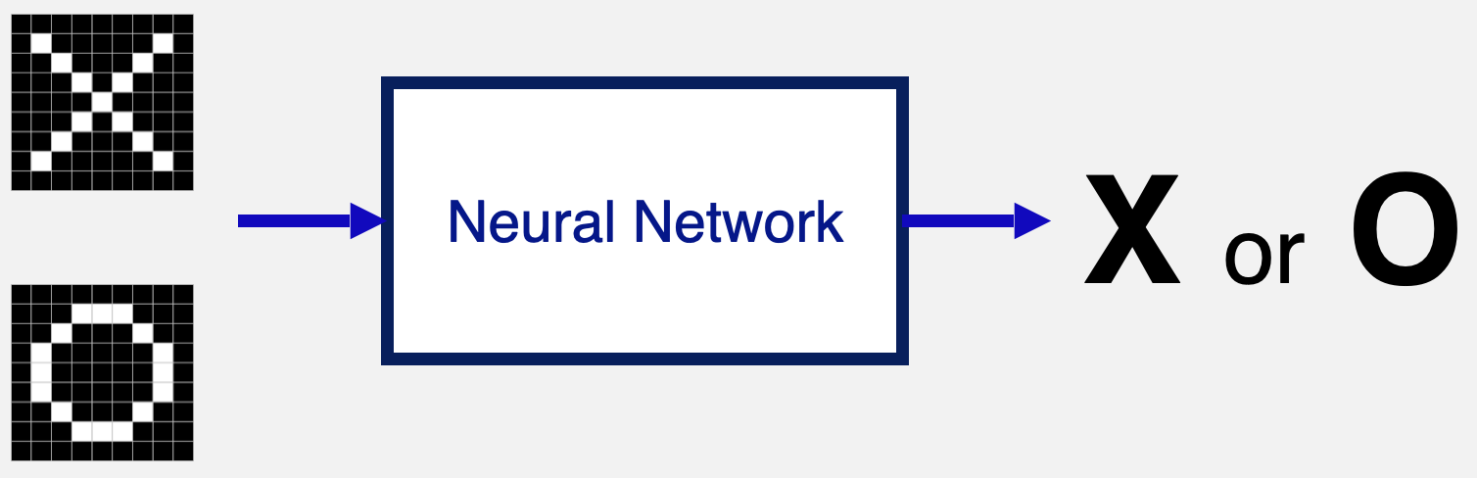
Example: Classifying X’s and O’s
Says whether a picture is of an X or an O
So far, our neural networks have relied on two fundamental mathematical operations:
Linear combinations (tensor multiplication) – Used to transform input data through weighted sums.
Nonlinear activations – Functions like ReLU or Sigmoid that introduce non-linearity, allowing the model to learn complex patterns.

Slide 24
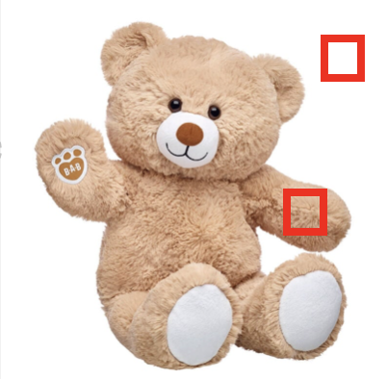
Example: Classifying X’s and O’s
Says whether a picture is of an X or an O
Flattening the image matrix into a long vector has several undesirable effects:
Must learn too many parameters: Flattening a 3024 × 3024 pixel color image (HD resolution) and connecting it to a single 100-neuron dense layer results in approximately 2.7 billion parameters
The local spatial connections between pixels, which are crucial for defining image features, are lost
Not robust to changes or distortions in the image

Slide 25
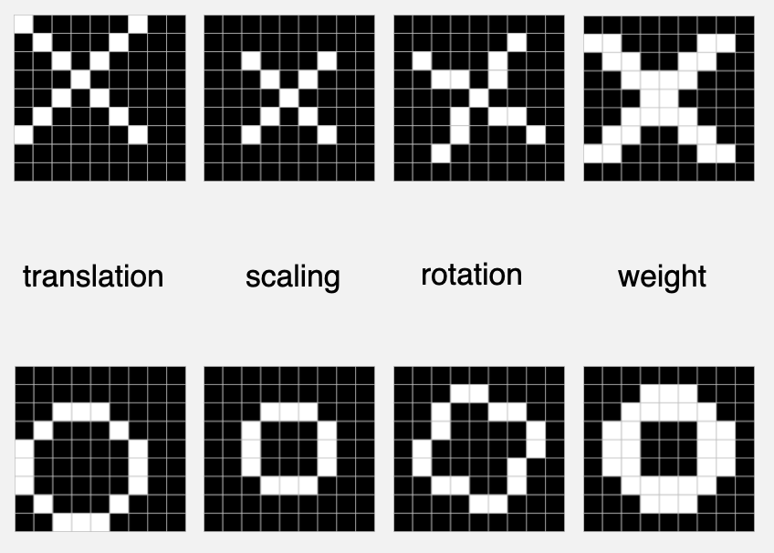
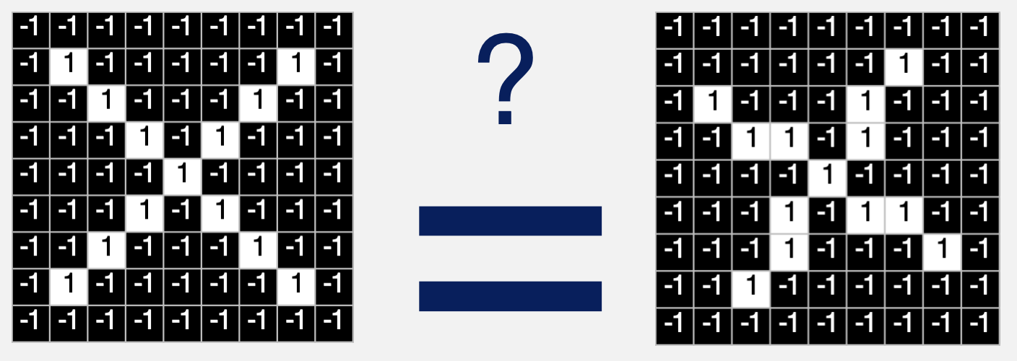
Example: Classifying X’s and O’s
Says whether a picture is of an X or an O
Challenging X’s and O’s
What the computer sees:

Slide 26
New Operations
Convolutional Neural Network (CNN) were developed to address these shortcomings:
Capture spatial dependencies: pixel position and neighborhood have semantic meaning
Handle Translations: elements of interest can appear anywhere in the image
There are 3 main steps in CNNs:
Feature Extraction (Convolution + Activation)
Downsampling (Pooling)
Classification (Fully Connected Layers)
Now, we introduce two additional operations that are crucial for processing spatial data, especially in CNNs.

Slide 27
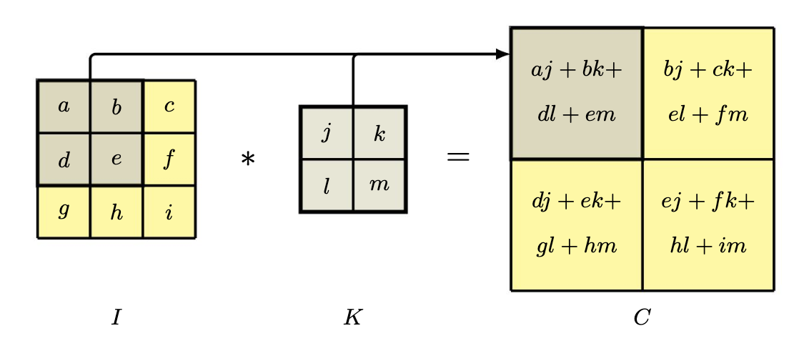
Convolutions
Note that the weights are shared as the kernel “slides” across the original tensor.
Practical:
Convolutions
Convolution operations – These apply filters (kernels) with parameter weights to extract local patterns such as edges, textures, or shapes from input data. Unlike fully connected layers, convolution preserves spatial structure.
Image source: Bishop, C. M., & Bishop, H. (2024).
Deep Learning: Foundations and Concepts. Springer.

Slide 28
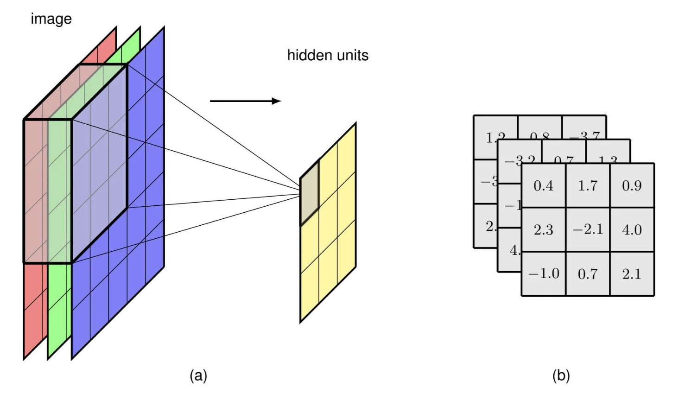
Multi-
Dimensional
Convolutions
Here the kernel is a 3 x 3 x 3 tensor.
Image source: Bishop, C. M., & Bishop, H. (2024).
Deep Learning: Foundations and Concepts. Springer.

Slide 29
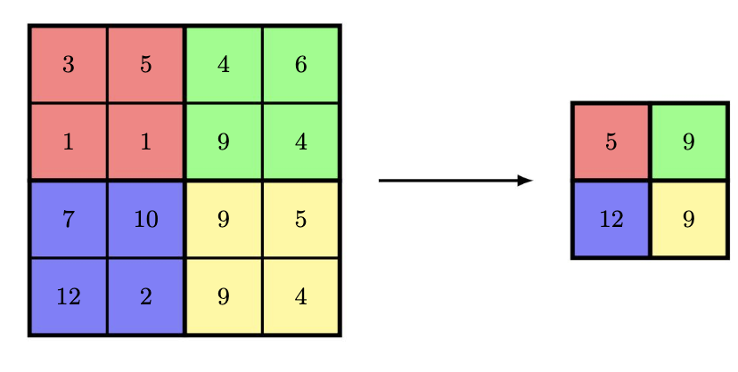
Pooling
Pooling layers – These downsample feature maps, reducing dimensionality while retaining important information. Common pooling techniques include max pooling (which keeps the highest value in a region) and average pooling (which takes the average value).
Image source: Bishop, C. M., & Bishop, H. (2024).
Deep Learning: Foundations and Concepts. Springer.

Slide 30
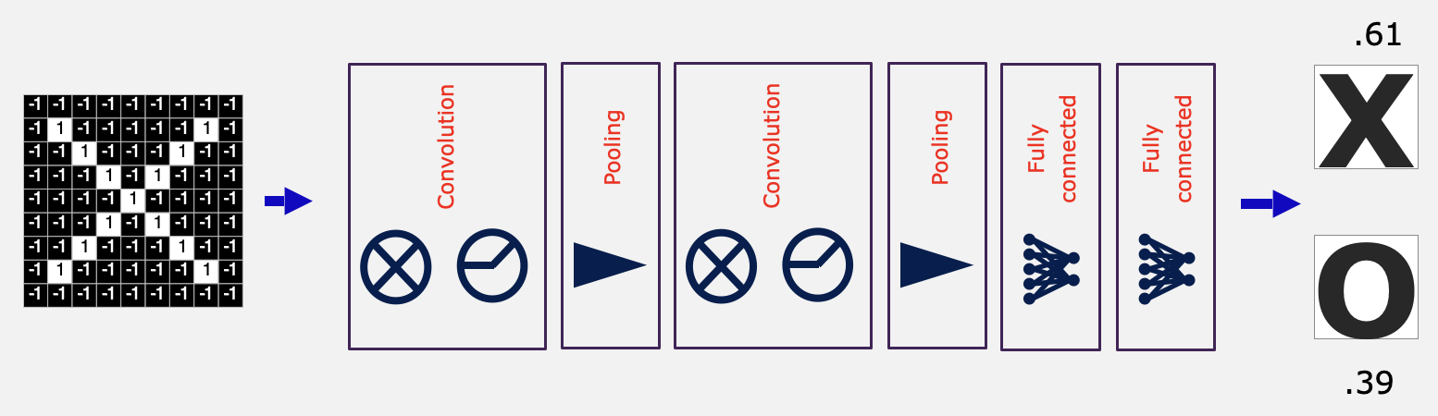
Example: Classifying X’s and O’s
Designing the architecture of your network includes deciding how many of each type of layer to have and in what order:
Convolution (number of filters, size of filters)
Pooling (window size, window stride)
Fully Connected Layer (number of neurons)

Slide 31
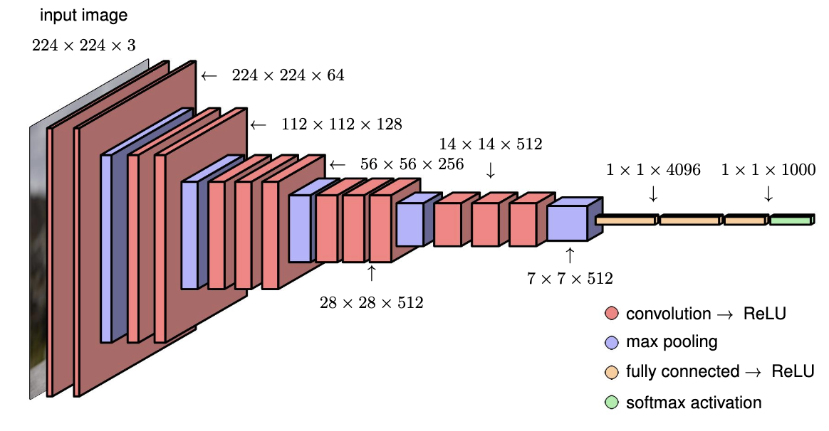
Modern CNN
Practical:
Convolutional Neural Networks (CNN)
Typical CNN (VGG-16)
Image source: Bishop, C. M., & Bishop, H. (2024).
Deep Learning: Foundations and Concepts. Springer.

Slide 32
Convolutional Neural Network in PyTorch
Class Activity: Adding a CNN model to the reusable codebase

